Slide 1
Data Structure and Algorithm
BAN 612

Slide 2
Introduction
In data analytics, computer science and statistics converge.
Statistical principles to write code: effectively explore the problem at hand.
Data structures, algorithms, and time-space complexity: program more efficiently and understand the tools that we use.

Slide 3

A Million-User App
Imagine you build a wildly popular app
While users love the app, the app is becoming slower and slower,
The main bottleneck: how user info is retrieved during authentication.
Current way: searches through an unsorted list of Python dictionaries until it finds the requested user ID.

Slide 4
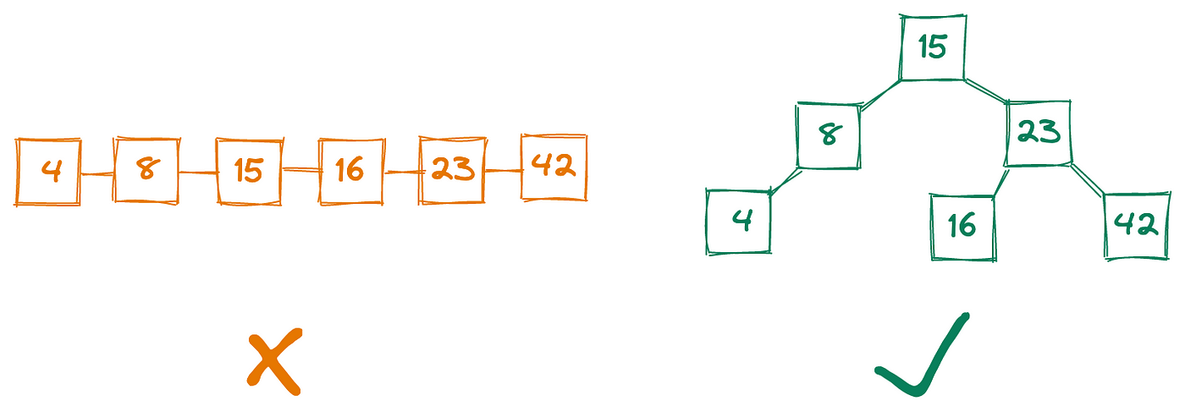
A Million-User App
How can we store user IDs in a way that lets us retrieve any ID as fast as possible?
Sorting the list might help.
A better approach: arrange user data in a binary search tree.

Slide 5
A Million-User App
This example highlights an important point:
The data structures our programs use can determine whether our code will scale as the amount of data grows, or whether we’ll need to rewrite everything from scratch every six months.

Slide 6
Algorithm
In programming, an algorithm is a process or set of rules to be followed in order to achieve a particular goal.
An algorithm is characterized by its running time (run-time), whether in terms of space or time.
When analyzing data, we are interested in the most efficient algorithm so that we can optimize our workflow.

Slide 7
Big O Notation
Big O is a measure of the “worst-case” efficiency.
an upper bound on how long it would take to accomplish a task
For example: searching for an element in an unsorted list is O(n)
in the worst case, you must search the entire list.
See examples in Python code.

Slide 8
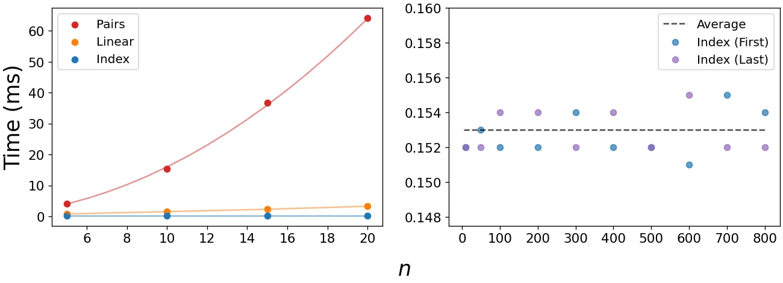
Running Time

Slide 9
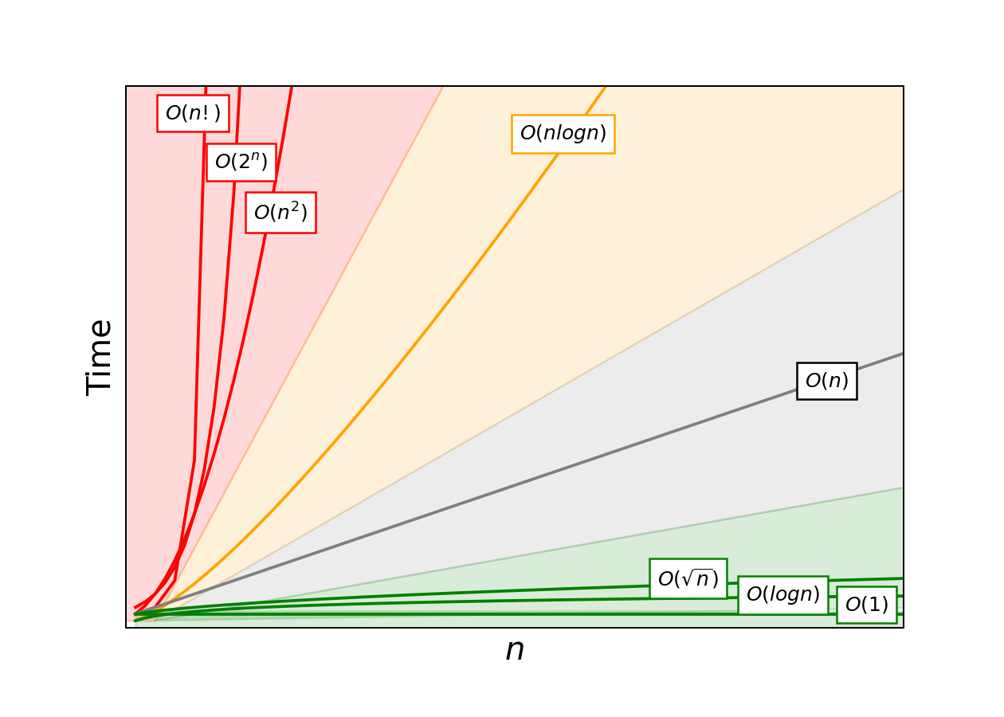
Big O Notation

Slide 10
O(2ⁿ) Algorithm
Red zone algorithms are often necessary for problems where you need to know every possible answer to a question. One example of an O(2ⁿ) algorithm is finding all subsets of an array.
A set of four elements like [A,B,C,D] will therefore have 2⁴, or 16, subsets:
[], [A], [B], [C], [D]
[A,B], [A,C], [A,D], [B,C], [B,D], [C,D]
[A,B,C], [A,B,D], [A,C,D], [B,C,D]
[A,B,C,D]

Slide 11
O(n!) Algorithm
An even worse runtime is O(n!). Permutations are a classic example of n-factorial complexity.
To find every possible arrangement of [A, B, C, D]
[A,B,C,D], [A,B,D,C], [A,C,B,D], [A,C,D,B], [A,D,B,C], [A,D,C,B]
[B,A,C,D], [B,A,D,C], [B,C,A,D], [B,C,D,A], [B,D,C,A], [B,D,A,C]
[C,A,B,D], [C,A,D,B], [C,B,A,D], [C,B,D,A], [C,D,B,A], [C,D,A,B]
[D,A,B,C], [D,A,C,B], [D,B,A,C], [D,B,C,A], [D,C,A,B], [D,C,B,A]

Slide 12
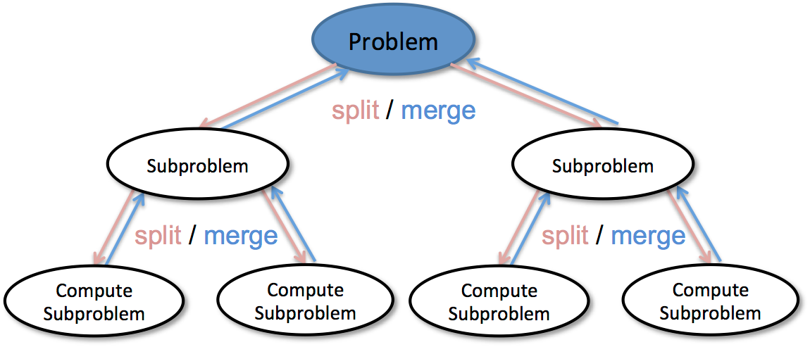
Recursion and D&C
Recursion:
Recursion is when a function calls itself.
See Python code: implementation of a factorial function.
Divide and Conquer (D&C)
determines the simplest case for the problem (AKA the base case) and
reduces the problem until it is now the base case.

Slide 13

Common Algorithms - Search
Suppose you wish to search for someone’s name in a phone book.

Slide 14
Simple Search
The worst case would require that you search through all the names in the phone book before you find the name of interest.
In general, simple search has a O(n) time.

Slide 15
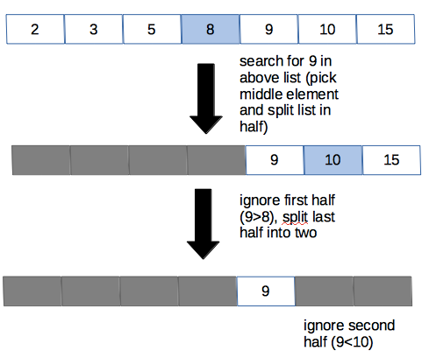
Binary Search
Instead of tediously going through each and every name in the phone book, we’re going to start in the middle of the phone book and go from there.
You take your sorted (this is important) data and find the midpoint.
Each time, you compare your target to the middle value.
If the target value is the same as the middle value, then your job is done.
Otherwise, you know which half of the list to eliminate based on the comparison.
You continue dividing until the target is found or the dataset can no longer be halved.
The Big O time is O(log n).

Slide 16
Common Algorithm - Sort
Selection Sort
Perhaps the most straightforward, ‘brute force’ way to sort your data.
Search through the list to find the largest number
Add that number to a new list
Go to the original list, search through it again to find the next largest number
Add that number to the new list and so on…
Takes O(n²) time.

Slide 17
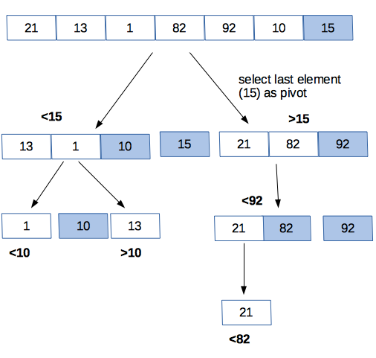
Quicksort
Pick an element from your list, known as the pivot.
The selection of a pivot is important in determining how quickly a quicksort algorithm will run.
For now, we can select the last element each time as the pivot.
Partition the list so that all numbers smaller than the pivot are to its left and all numbers greater than the pivot are to its right.
For each ‘half’ of the list, you can treat it as a new list with a new pivot and rearrange each half until it is sorted.
At worst, it can take O(n²) time.
However, if the pivot is always some random element in the list, quicksort runs in O(n log n) time on average.

Slide 18
Mergesort
For the merge sort algorithm, the list would be broken down into its individual elements.
Ordered pairs are then created from these elements (with the smaller number to the left).
These ordered pairs are then grouped into ordered groups of four and this continues until the final merged, sorted list is created.
As with quicksort, mergesort is a D&C algorithm
Mergesort runs on O(n log n) time

Slide 19
Data Structure
Time is not the only limited resource at our disposal. Any computer has only so much space (also known as memory) and any given algorithm can also be characterized by the amount of working storage that it requires. One can imagine that as our dataset of interest grows, space becomes more of a concern.
When working with data, selection of the correct data structure allows us to optimize both time and space, such that our pipeline runs smoothly enough to allow us to draw conclusions

Slide 20

Data Structure
Imagine you need to put away some clean laundry.
A data structure with low write time but high read time would be a pile of clothes on the ground.
Adding to this pile is blazing fast, but retrieving any particular item is slow.
An alternate method would be to neatly arrange your clothes in your dresser and closet.
This method would take longer to put away your clothes, but you’d be able to more quickly access any item you searched for.

